Slide 1
Book1
File created on: 2021-03-11 7:44:00 AM EST

Slide 2
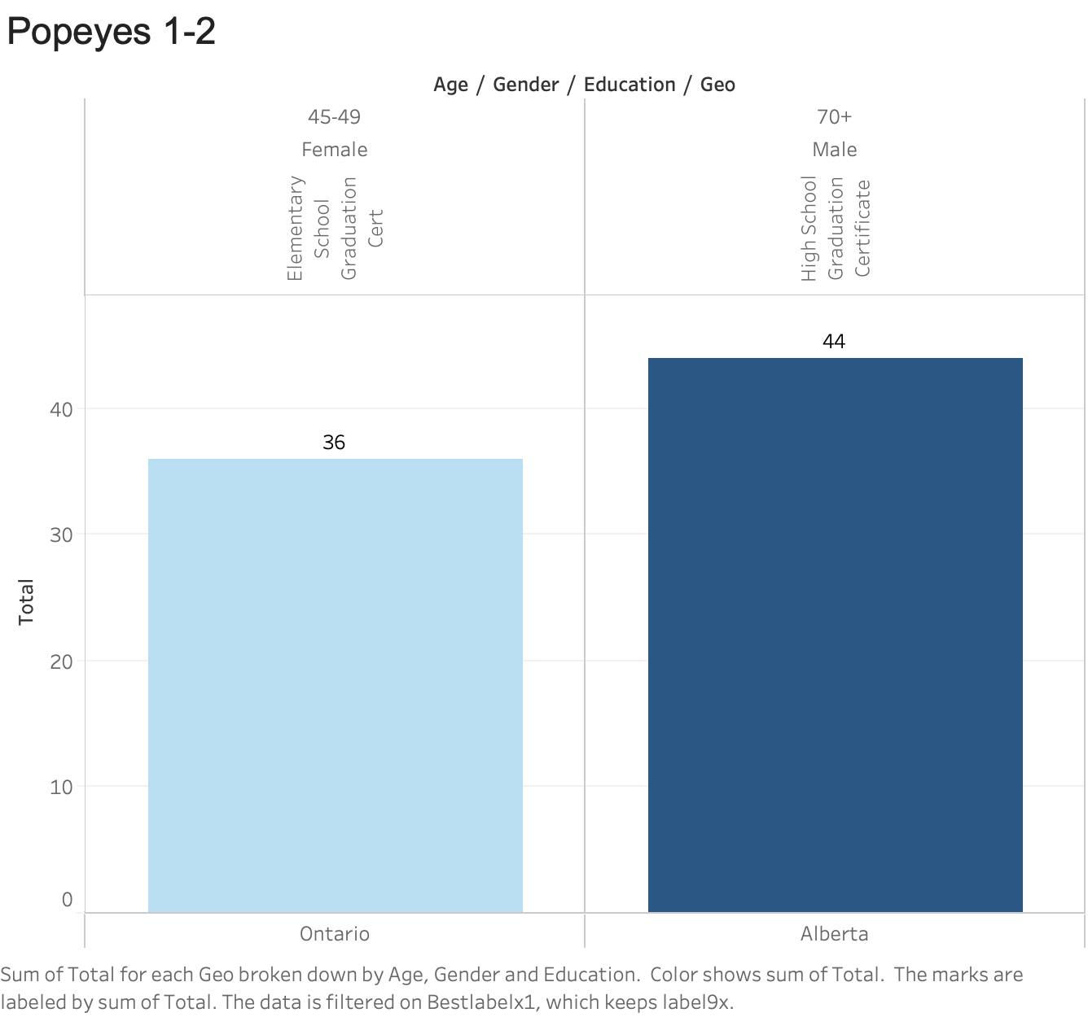

Slide 3


Slide 4
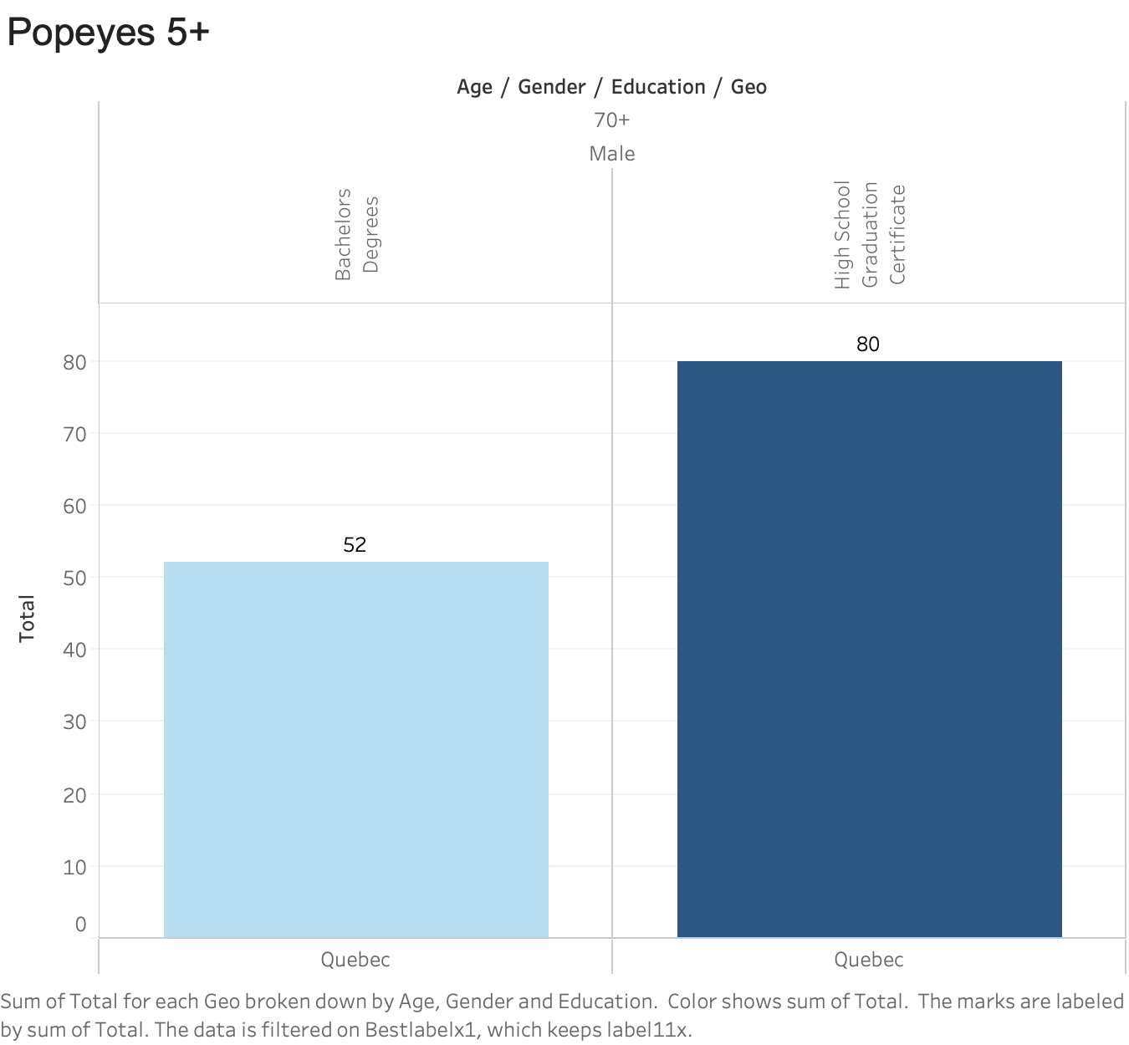

Slide 5


Slide 6


Slide 7
